Slide 1
Analysis of User Behavior for Twitter Posts on Hadoop
- Abhilash Saj

Slide 2
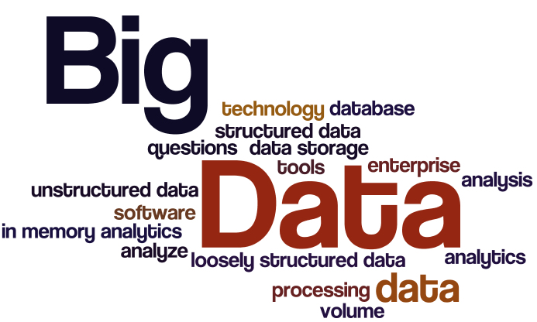
INTRODUCTION – BIG DATA
Collection of large datasets
Structured and unstructured data
Difficult to process and analyze

Slide 3
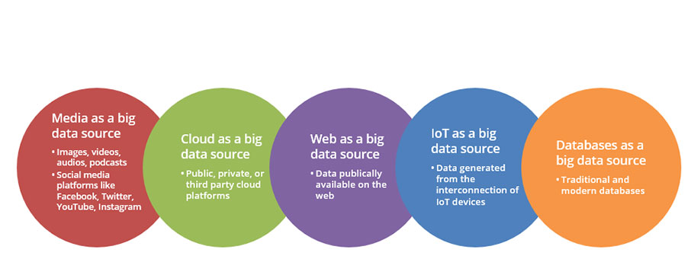
SOURCES OF BIG DATA

Slide 4
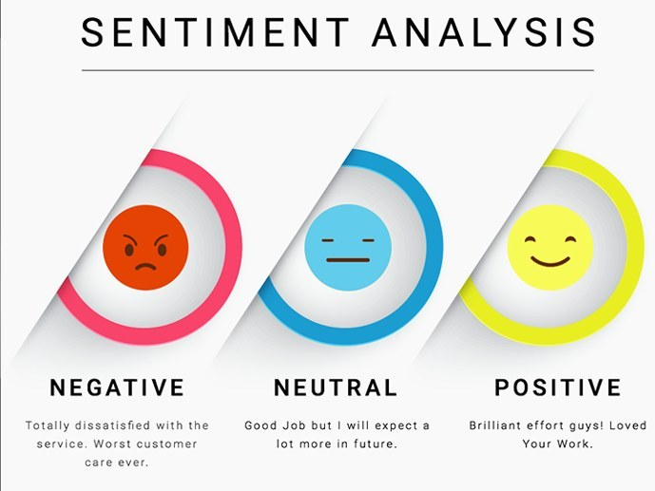

Slide 5
Project
Tweet analysis for user behavior.
Tweets are available in JSON format which is to be converted into a structured data.
Output how users behave for particular topic in certain country and city.

Slide 6
Challenges with social media data
Grammar and Spellings
Trustworthiness
Format
Language

